Slide 1
Michael Arbib: CS564 - Brain Theory and Artificial Intelligence
Lecture 5. Adaptive Networks I. Hebbian learning, Perceptrons; Landmark Learning
Reading Assignments:
HBTNN:
  Associative Networks (Anderson)
  Perceptrons, Adalines, and Back-Propagation (Widrow and Lehr)
TMB2:
  Section 3.4
NSL Book
  Chapter 12: The Associative Search Network: Landmark Learning and Hill Climbing

Slide 2
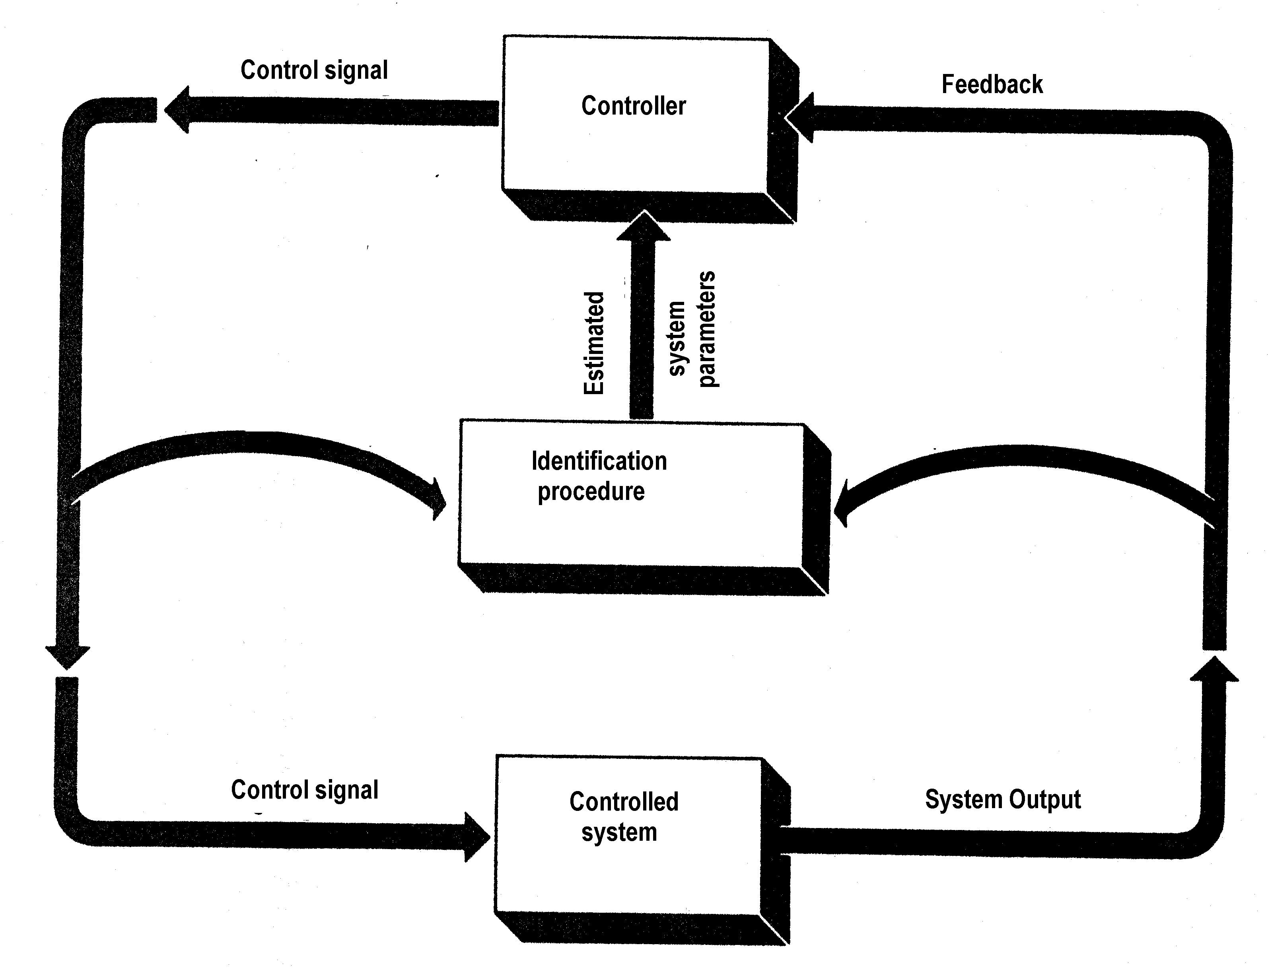
Identification Procedures and Adaptive Control

Slide 3
Samuel's 1959 Checkers Player
Programming a computer to play checkers.
Look several moves ahead: Max-min strategy
Prune the search tree
Give the computer a way to determine the value of various board positions.
Not knowing how we evaluate a board, we can at least be sure that its value depends on such things as
  the number of pieces each player has
  the number of kings
  balance
  mobility
  control of the center.
To these we can assign precise numbers.
Pick 16 such parameters which contribute to evaluation of the board.
Evaluation = f (x₁,x₂,...,x₁₆) What is f?

Slide 4
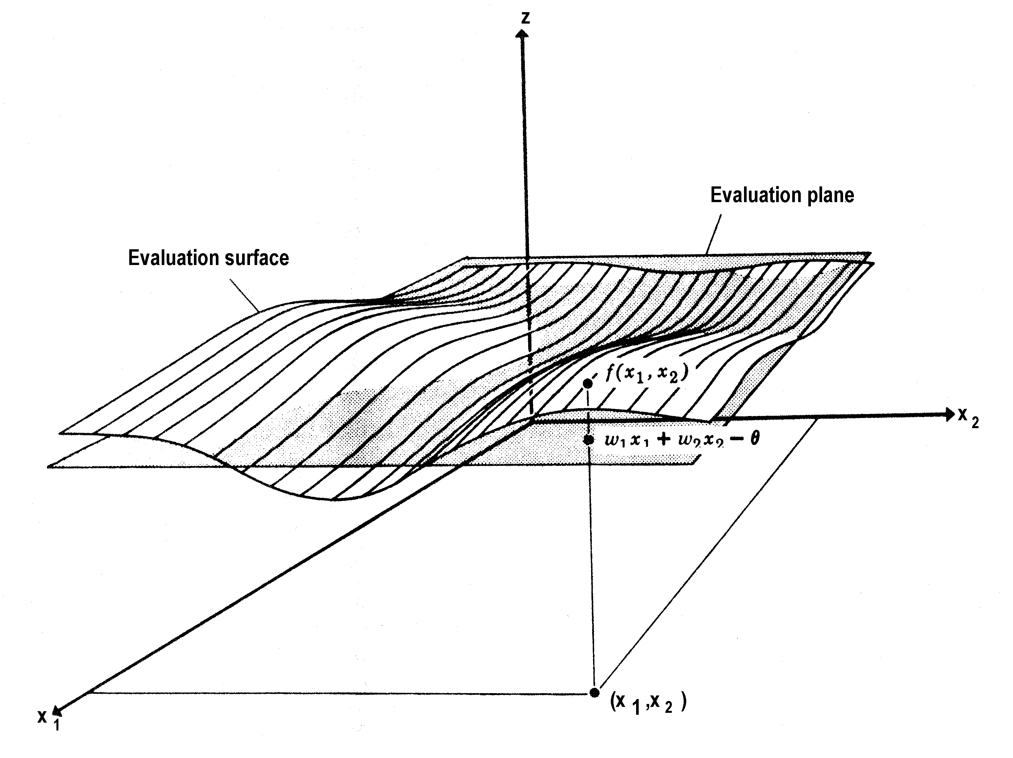
Approximating an Evaluation Surface by a (Hyper)plane

Slide 5
Approximating an Evaluation Surface by a (Hyper)plane
Samuel’s 1959 strategy was
  in addition to cutting down the “lookahead”
to guess that
  the evaluation function was approximately linear.
… using a hyperplane approximation to the actual evaluation to play a good game:
z = w₁x₁ + ... +w₁₆x₁₆ - θ (a linear approximation )
for some choices of the 16 weights w₁, ..., w₁₆, and θ.
In deciding which is better of two boards
the constant θ is irrelevant —
so there are only 16 numbers to find in getting the best linear approximation.

Slide 6
The Learning Rule
Orient an evaluation hyperplane in the
17-dimensional space:
On the basis of the current weight-setting, the computer chooses a move which appears to lead to boards of high value to the computer.
If after a while it finds that the game seems to be going badly, in that it overvalued the board it chose, then it will increase those parameters which yielded a positive contribution while reducing those that did not.
The General Theory (Lecture 14):
Barto on “Adaptive Critics” for Reinforcement Learning
  replacing reinforcement by “expected reinforcement”

Slide 7
Classic Models for Adaptive Networks
The two classic learning schemes for McCulloch-Pitts
formal neurons Σ_{i} w_{i}x_{i} ≥ θ
• Hebbian Learning - Amplifying Predispositions
Hebb's scheme in The Organization of Behaviour (1949)
  — strengthen a synapse whose activity coincides with the firing of the postsynaptic neuron
  [cf. Hebbian Synaptic Plasticity, Comparative and Developmental Aspects (HBTNN)]
• The Perceptron - Learning with a Teacher(Rosenblatt 1962)
  — strengthen an active synapse if the efferent neuron fails to fire when it should have fired;
  — weaken an active synapse if the efferent neuron fires when it should not have fired.

Slide 8
Hebb's scheme
Hebb (p.62, 1949):
  When an axon of cell A is near enough to excite a cell B
  and repeatedly or persistently takes part in firing it,
  some growth process or metabolic change takes place in one or both cells, such that A's efficiency as one of the cells firing B, is increased.
Hebb (1949) developed a multi-level model of
perception and learning, in which the units of thought
were encoded by cell assemblies, each defined by activity reverberating in a set of closed neural pathways.
The essence of the Hebb synapse is to increase coupling between coactive cells so that they could be linked in growing assemblies.
Hebb developed similar hypotheses at a higher hierarchical level of organization, linking cognitive events and their recall into phase sequences, temporally organized series of activations of cell assemblies.

Slide 9
Hebb’s Rule
The simplest formalization of Hebb’s rule is
to increase w_{ij} by: Δw_{ij} = k y_{i} x_{j} (1)
x_{j}
y_{i}
where synapse w_{ij} connects a presynaptic neuron with firing rate x_{j} to a postsynaptic neuron with firing rate y_{i}.
Peter Milner noted the saturation problem
von der Malsburg 1973 (modeling the development of oriented edge detectors in cat visual cortex [Hubel-Wiesel: V1 simple cells]) augmented Hebb-type synapses with
a normalization rule to stop all synapses "saturating"
Σ w_{i} = Constant
lateral inhibition to stop the first "experience" from "taking over" all "learning circuits”: it prevents nearby cells from acquiring the same pattern thus enabling the set of neurons to "span the feature space"

Slide 10
Lateral Inhibition Between Neurons
The idea is to use competition between neurons so that if one neuron becomes adept at responding to a pattern, it inhibits other neurons from doing so.
[See Competitive Learning in HBTNN]
If cell A fires better than cell B for a given orientation θ, then it fires more than B and reduces B's response further by lateral inhibition
so that A will adapt more toward θ and
B will adapt less, and the tendency will continue with each presentation of θ.
The final set of input weights to the neuron depends both
on the initial setting of the weights, and
on the pattern of clustering of the set of stimuli to which it is exposed.
capturing the statistics of the pattern set
A
B
B

Slide 11
Unsupervised Hebbian Learning
tends to sharpen up a neuron's predisposition
"without a teacher,"
the neuron’s firing becomes better and better correlated
with a cluster of stimulus patterns.

Slide 12
Hebbian Learning can be Supervised
Supervised Hebbian Learning
is based on having an activation line separate from
the pattern lines with trainable synapses and using
the activation line to command a neuron to fire - thus associating the firing of the neuron with those input patterns used on the occasions when it was activated.
[This relates to the idea of associative memory.]
activation line/teacher
pattern lines
.
.

Slide 13
Supervised Hebbian learning is closely related to
Pavlovian conditioning
Training Input (US): e.g., sight of food
CS: sound of bell
R: salivation
The response of the cell being trained corresponds to the conditioned and unconditioned response (R),
the training input corresponds to the unconditioned stimulus (US), and
the trainable input corresponds to the conditioned stimulus (CS).
[Richard Thompson: US = air puff to eye; R = blink; CS = tone]
Since the US alone can fire R, while the CS alone may initially be unable to fire R,
the conjoint activity of US and CS creates the conditions for Hebb's rule to strengthen the US→R synapse,
so that eventually the CS alone is enough to elicit a response.

Slide 14
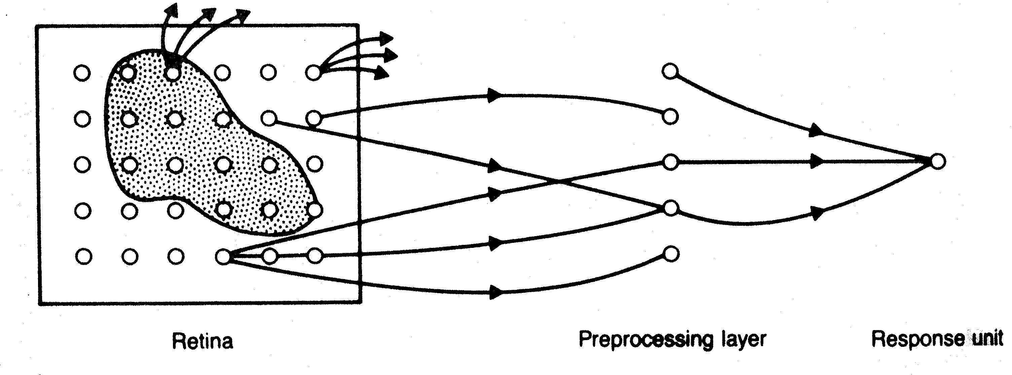
Pattern Classification by Neurons
Rosenblatt (1958) explicitly considered the problem of
pattern recognition where a teacher is essential -
  for example placing b, B, b and B in the same category.
He introduced Perceptrons - neural nets that change with “experience” using an error-correction rule designed to
change the weights of each response unit when it makes erroneous responses to stimuli presented to the network.
A simple Perceptron has no loops in the net, and only the weights to the output units can change:

Slide 15
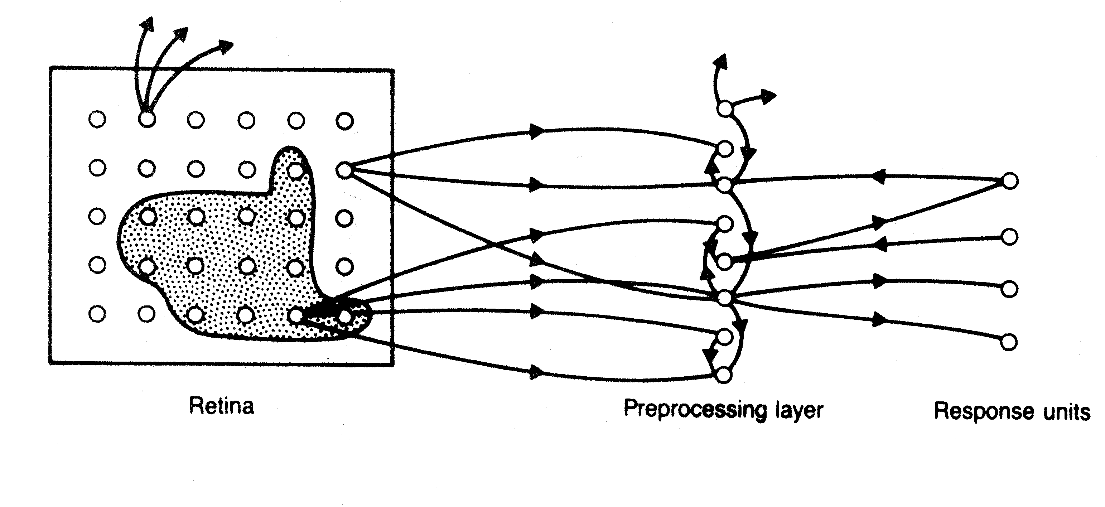
Simple vs. General Perceptrons
The associator units are not interconnected, and so
the simple perceptron has no short-term memory.
If the units are cross-coupled - the net may then have multiple layers, and loops back from an “earlier” to a “later” layer.
Lectures 16 and 17 [NSLJ] will discuss back-propagation: extending perceptron techniques to loop-free multi-layer feedforward networks by “credit assignment” for “hidden Layers” between input and output.

Slide 16
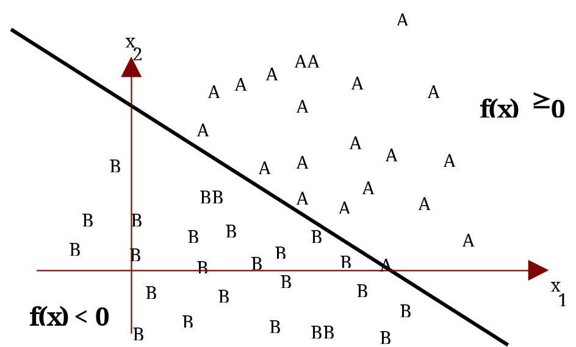
Linear Separability
Two categories are linearly separable patterns if in fact their members can be separated by a line or (more generally) hyperplane.
A linear function of the form
f(x) = w₁x₁+ w₂x₂+ ... w_{d}x_{d}+w_{d+1} (w_{d+1} = - θ)
is a two-category pattern classifier.
f(x) = 0  w₁x₁+ w₂x₂+ ... w_{d}x_{d}+w_{d+1} = θ
gives a hyperplane as the decision surface
Training involves adjusting the coefficients (w₁,w₂,...,w_{d},w_{d+1}) so that the decision surface produces an acceptable separation of the two classes.

Slide 17
General Training Strategy
Pick a “representative set of patterns”
Use a Training Set to adjust synaptic weights using a
learning rule.
With weights fixed after training, evaluate the weights by scoring success rates on a Test Set different from the training set.
Rosenblatt (1958) provided a learning scheme with the property that
if the patterns of the training set (i.e., a set of feature vectors, each one classified with a 0 or 1) can be separated by some choice of weights and threshold,
then the scheme will eventually yield a satisfactory setting of the weights.

Slide 18
Perceptron Learning Rule
The best known perceptron learning rule
  strengthens an active synapse if the efferent neuron fails to fire
  when it should have fired, and
  weakens an active synapse if the neuron fires when it should not have:
Δw_{ij} = k (Y_{i} - y_{i}) x_{j} (2)
As before, synapse w_{ij} connects a neuron with firing rate x_{j} to a neuron with firing rate y_{i}, but now
  Y_{i} is the "correct" output supplied by the "teacher."
  (This is similar to the Widrow-Hoff [1960] least mean squares model of adaptive control.)
The rule changes the response to x_{j} in the right direction:
    If the output is correct, Y_{i} = y_{i} and there is no change, Δw_{ij} = 0.
    If the output is too small, then Y_{i} - y_{i} > 0, and the change in w_{ij} will add Δw_{ij} x_{j} = k (Y_{i} - y_{i}) x_{j} x_{j} > 0 to the output unit's response to (x₁, . . ., x_{d}).
    If the output is too large, Δw_{ij} will decrease the output unit's response.

Slide 19
The Perceptron Convergence Theorem
Thus, w + Δw classifies the input pattern x
"more nearly correctly" than w does.
Unfortunately, in classifying x "more correctly" we run
the risk of classifying another pattern "less correctly."
However, the perceptron convergence theorem shows that Rosenblatt's procedure does not yield an endless seesaw, but will eventually converge to a correct set of weights if one exists, albeit perhaps after many iterations through the set of trial patterns.
[See Brains, Machines, and Mathematics, 2nd Edition, pp. 66-69 for a proof.]

Slide 20
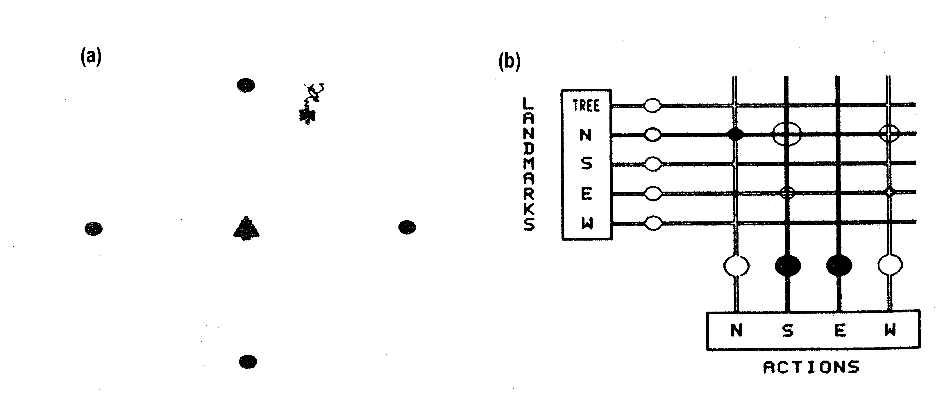
The Robot, Four Landmarks (N, E, W, S) and the Goal (the Tree “at the top of the Hill”)
The “payoff function” z is a scalar quantity that increases as the robot gets closer to the goal:
Think of z as “height on a hill” so goal-seeking becomes
“hill-climbing”
N
W
E
S

Slide 21
Hill-Climbing and Landmark Learning
“Hill-Climbing in the Fog”:
At time t the robot takes a single step in direction i(t),
moving from a position with payoff z(t)
to one with payoff z(t+1).
If z(t+1)- z(t) > 0, then the robot's next step is in the same direction, i(t+1) = i(t), with high probability.
If z(t+1)- z(t) < 0, then i(t+1) is chosen randomly.
cf. bacterial chemotaxis: run-and-twiddle mechanism.
Landmark Learning
Barto and Sutton show how to equip our robot with a simple nervous system (four neurons!) which can be trained to use "olfactory cues" from the four landmarks to improve its direction-finding with experience.

Slide 22
The Four-Neuron Adaptive Controller
Learning Problem: Find the right synaptic weights
Payoff Signal →
Signals from
Landmark
Sensors
Commands to
Actuators
Note: The Payoff Signal does not provide explicit error
signals to each actuator command.
Think of z(t)-z(t-1) as (positive or negative) reinforcement.

Slide 23
Hill-Climbing in Weight Space
The net can "learn" appropriate values for the weights.
We here raise hill-climbing to a more abstract level:
instead of hill-climbing in the physical space
— choose a direction again if it takes the robot uphill —
we now conduct
>>>hill-climbing in weight space<<<
At each step, the weights are adjusted in such a way as to improve the performance of the network.
The z input, with no associated weights of its own, is the "teacher" used to adjust the weights linking sensory inputs to motor outputs.

Slide 24
Landmark Learning
Let output s_{j}(t) = Σ_{i}w_{ji}(t)x_{i}(t) (1)
Since current weights w may not yet be correct, we add
a noise term, setting the output of element j at time t to
y_{j}(t) = 1 if s(t) + NOISE_{j}(t) > 0, else 0 (2)
  where each NOISE_{j}(t) is a normally distributed random variable with zero mean (each with the same variance).
The weights change according to:
Δw_{ji}(t) = c[z(t)-z(t-1)]y_{j}(t-1)x_{i}(t-1) (3)
where c is a positive "learning rate".
Think of z(t)-z(t-1) as (positive or negative) reinforcement.

Slide 25
Δw_{ji}(t) = c[z(t)-z(t-1)]y_{j}(t-1)x_{i}(t-1)
w_{ji} will only change if
a j-movement takes place (y_{j}(t-1)>0) and
the “robot” is near the i-landmark (x_{i}(t-1)>0)
It will then change in the direction of z(t)-z(t-1).
Again view z(t) as "height on a hill”:
w_{ji} increases and a j-movement becomes more likely —
if z increases (the “robot” moves uphill); while
w_{ji} decreases and a j-movement becomes less likely if the robot moves downhill.
The w's are shifting in an abstract 16-dimensional space of weight-settings.

Slide 26
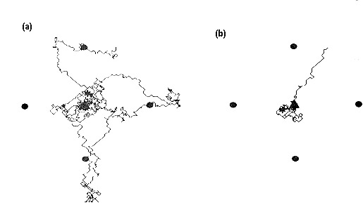
Before and After Learning

Slide 27
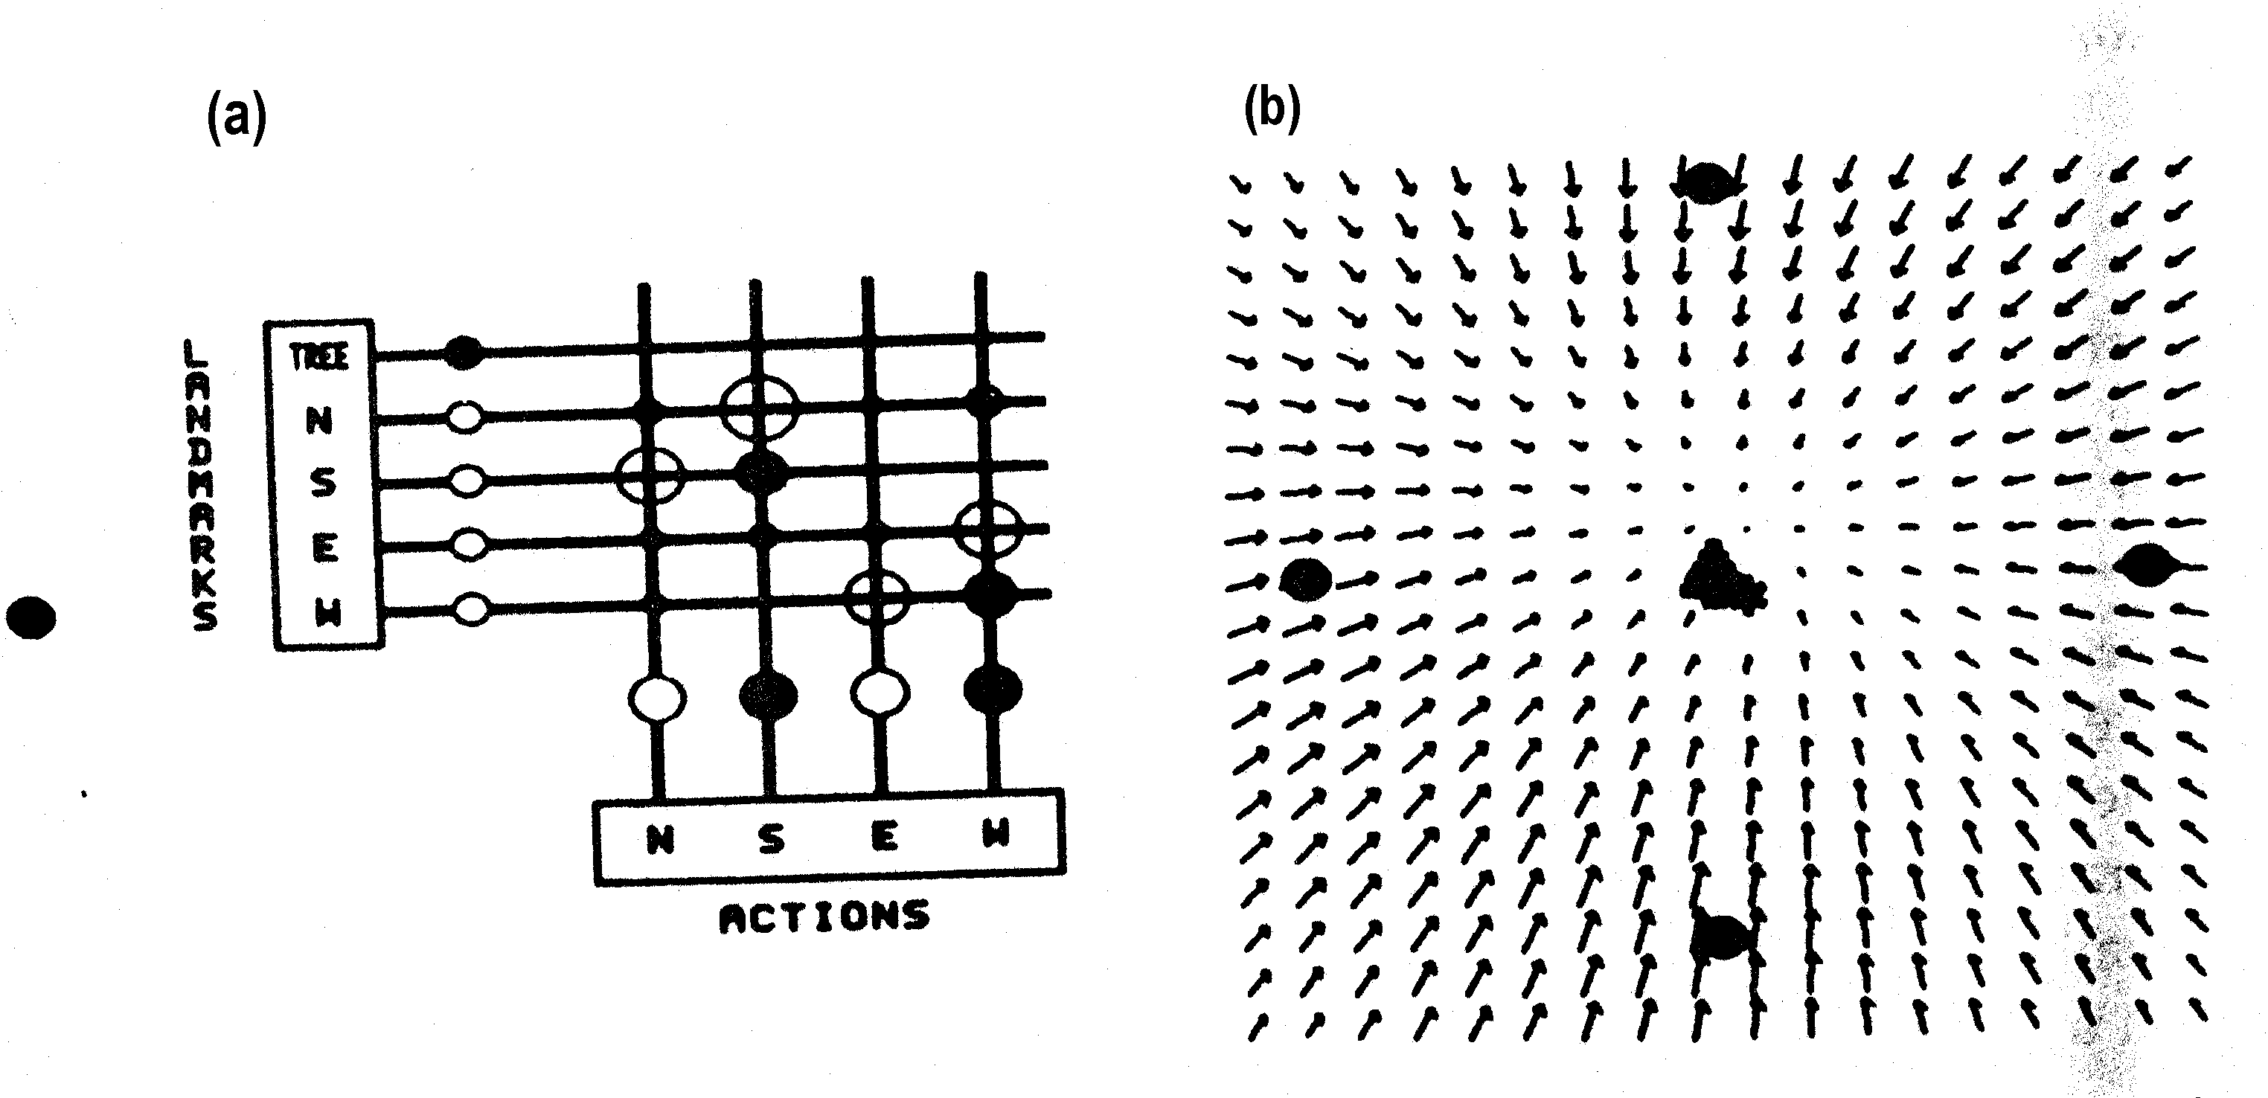
Learning a Map Implicitly
16 synaptic weights encode movement vectors at 400 locations in space

